Slide 1
Comenius Visit InegÖl, Turkey September 2012

Slide 2
First, Guildford to Heathrow by car…

Slide 3
Next, Heathrow to Istanbul by aeroplane…

Slide 4
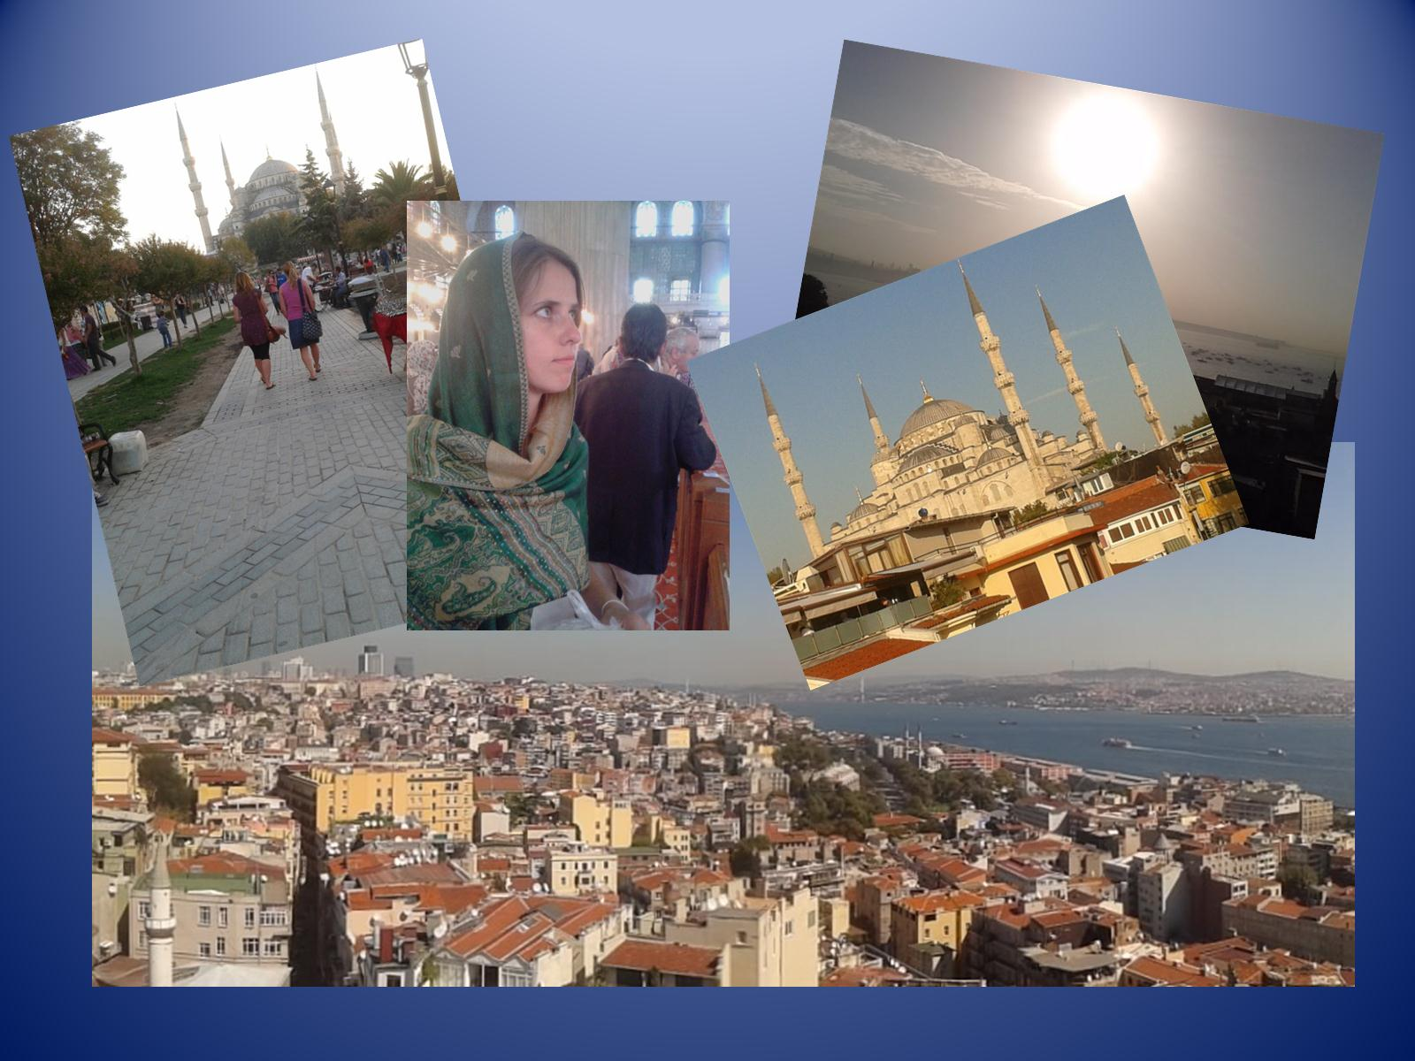

Slide 5
Then, Istanbul to InegÖl by coach and ferry…

Slide 6
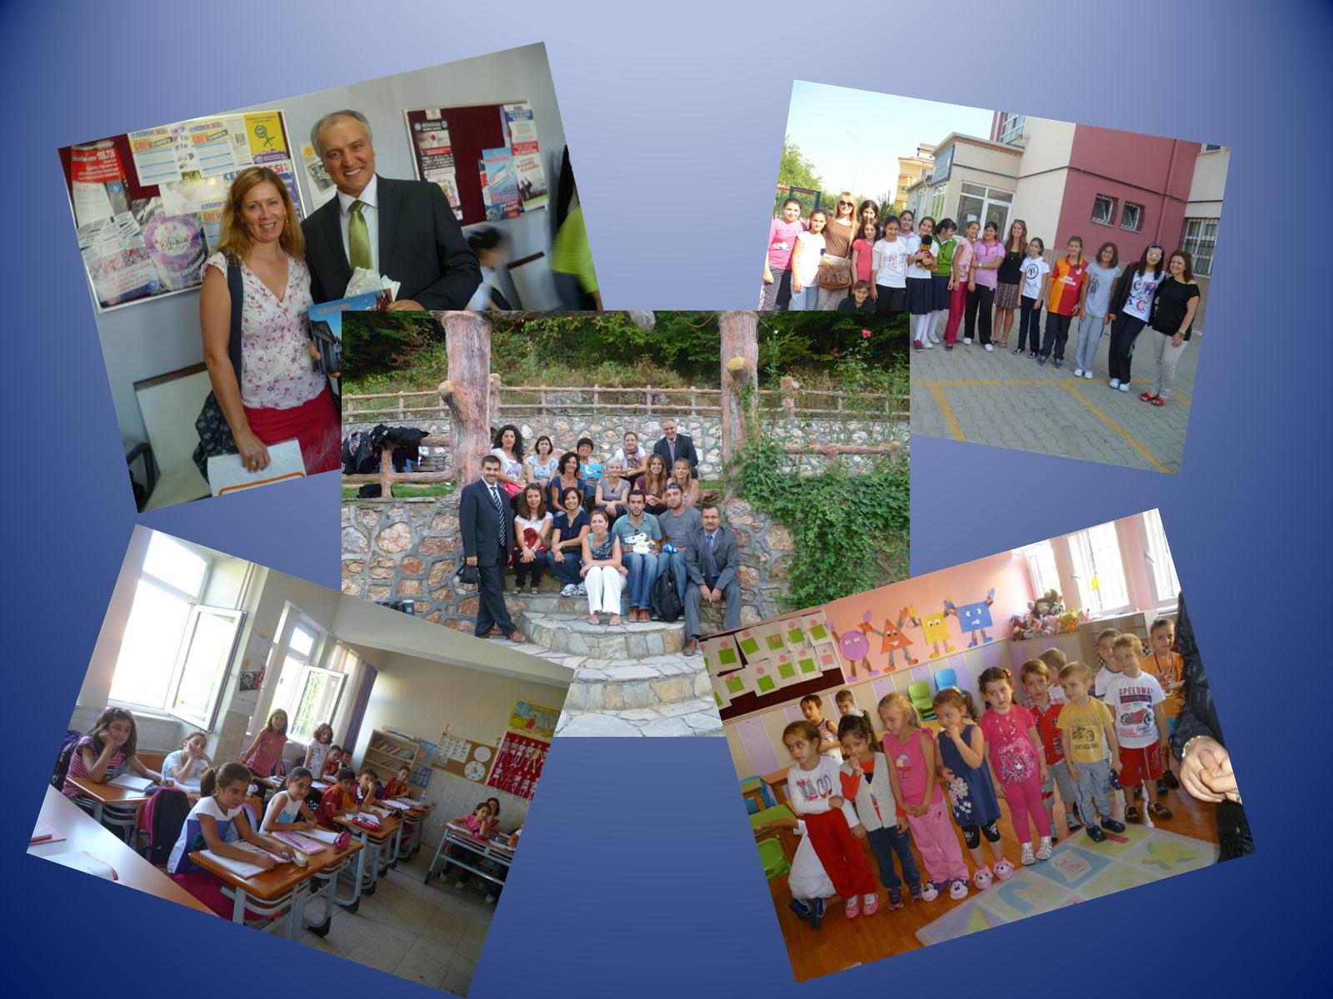

Slide 7
Next, InegÖl to Bursa by coach…

Slide 8
Then, InegÖl to Istanbul by coach and ferry…

Slide 9
Next, Istanbul to Heathrow by aeroplane…

Slide 10
Finally, Heathrow to Guildford in Helen’s car…

